Slide 1

Green Pace
Security Policy Presentation
Developer: Bradlay Mabalo
SNHU CS 405

Slide 2

OVERVIEW: DEFENSE IN DEPTH

Slide 3
THREATS MATRIX
Show how likely it is for a threat to Occurred
Likely High chance to occur | Priority Standards with higher relevance
Low priority Standards with lower relevance | Unlikely Lower chance to occur

Slide 4
10 PRINCIPLES
Validate Input Data
Heed Compiler Warnings
Architect and Design for Security Policies
Keep It Simple
Default Deny
Adhere to the Principle of Least Privilege
Sanitize Data Sent to Other Systems
Practice Defense in Depth
Use Effective Quality Assurance Techniques
Adopt a Secure Coding Standard

Slide 5
CODING STANDARDS
Rule | Severity | Likelihood | Remediation Cost | Priority | Level
STD-001-CPP | High | Unlikely | Medium | High | 2
[STD-INT32-C] | High | Likely | High | P9 | L2
[STD-MSC52-CPP] | Medium | Probable | Medium | P8 | L2
[STD-STR50-CPP] | High | Likely | Medium | P18 | L1
[STD-STR02-C] | High | Likely | Medium | P18 | L1
[STD-MEM52-CPP] | High | Likely | Medium | P18 | L1
[STD-DCL55-CPP] | Low | Unlikely | High | P1 | L3
[STD-ERR51-CPP] | Low | Probable | Medium | P4 | L3
[STD-CTR51-CPP] | High | Probable | High | P6 | L2
[STD-FIO50-CPP] | Low | Likely | Medium | P6 | L2
[STD-DLC52-CPP] | Low | Unlikely | Low | P3 | L3

Slide 6
ENCRYPTION POLICIES
Encryption in:
Rest: This will safeguard information when it is being stored in any medium, including databases, mobile devices, computers, and the cloud. AxCrypt and InnoD8 are just two examples of available tablespace encryption software. These resources are crucial for preventing information theft, whether it be digital or physical.
Flight: Sending information using encrypted methods. This is implemented in various transfer protocols, including TSL and SFTP. For the sake of security, this method of transmitting firm data should be employed whenever possible.
Use: This refers to the method of encrypting memory contents even when they are being accessed. This can reduce the likelihood of memory loss due to a crash that was forced. Bitlocker is one such program that encrypts all of a computer's data so that it can't be accessed without the right key. All of the company's information needs to be treated like this.

Slide 7
TRIPLE-A POLICIES
Authentication:
A user's identity can be validated through the authentication process. Several strategies exist for doing so. By using authentication methods such as username/password, single-sign-on, biometrics, or digital certificates. It's important to check out every user. Theft and hacking attempts will be thwarted in this way.
Authorization:
A user's level of authorization determines which system resources (such as files, folders, emails, and programs) they have access to. In this way, sensitive data on the system's servers will be protected, for example against a hacker who stole a clerk's credentials.
Accounting:
Accounting is the process of keeping track of and analyzing data about users' actions and interactions. This would cover actions like logging in, downloading files, and making a new account. This also includes each time databases or files are updated. This can be useful for preventing theft between companies and for tracing a user's actions within a system if they gain unauthorized access.

Slide 8
Unit Testing
Unit tests validate various collection object attributes. This will demonstrate the usefulness of unit tests through a number of real-world situations.

Slide 9
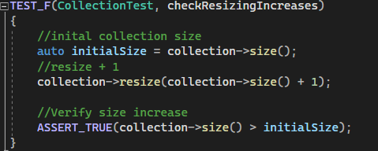
Resize the Collection
This test will verify if the collection is resizable.

Slide 10
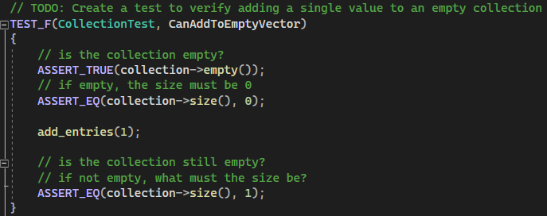
Adding a value
Verify if collection is empty

Slide 11

AUTOMATION SUMMARY

Slide 12
TOOLS
DevSecOps is a pipeline that incorporates security practices into the whole DevOps workflow. As a result, security might evolve into a crucial component of the rapidly evolving technological landscape. This will also ensure the organization is as safe as possible from external dangers.
Several resources are available to aid in the delivery of security services. CPPChecker, a Google testing framework for static code analysis, is useful for unit testing C++ applications. These development platforms are simply the tip of the iceberg; additional protocols and hardware-based security measures exist to protect sensitive enterprise information.

Slide 13
RISKS AND BENEFITS
 | Now | Wait
Benefits | reduces the potential for future harm Long-term cost savings possible if attacks can be stopped in time. Quickly secure sensitive data and maintain our clients' confidence in us. | Accelerating the software development life cycle
Risk | Perhaps lacks the resources to take immediate action Cost might be higher upfront | Threat can occur in the meantime Client confidence lost in the event of a data leak

Slide 14
RECOMMENDATIONS
Follow security standards
Encryption Policies
Make Constant Changes to the Policy
Reference All CERT Coding Standards
Get started right away with the Encryption and Triple-A policies.
Teamwork
Security Training
Start Defense-in- Depth layers

Slide 15
CONCLUSIONS
Defense in Depth: Having multiple layers of defense is essential for preventing attacks and mitigating the effects of even minor ones.
Authentication and Authorization: Data security relies heavily on the verification of system users and their permissions.
Tools: Use supplementary external tools to reinforce your already robust network security.
Priority: Prioritize safety measures to ensure the long-term success of the company.

Slide 16
REFERENCES
Carnegie Mellon Umiversity Software Engineering Institute. SEI CERT C++ Coding Standard.
Cerber EDU. What is Defense in Depth? Retrieve from: https://www.forcepoint.com/cyber-edu/defense-depth
Gilbert.M (March 1, 2023). Why DevSecOps Automation is Important for your Business

